Slide 1

REST API/Back End DEVELOPMENT

Slide 2

Prerequisite
REST API DEVELOPMENT
Fundamental understanding on node & express
Follow my YouTube play list on this

Slide 3
This course cover
REST API DEVELOPMENT
Introduction of Rest API
Rest API Best Practices
Rest API Security
Express Rest API Essential Packages
Express Rest API Structure
Step By step Express Rest API Development With Mongo
Rest API Documentation Preparation
Practice project

Slide 4
Course Benefits
REST API DEVELOPMENT
MERN Stack এর Server-Side এর বিষয় গুলো এই সিরিজ থেকে স্পষ্ট হয়ে যাবে।
যারা Mobile App/ Desktop App / React App/ Vue App এর জন্যে আলাদা Express Service Based কাজ করেন তাদের জন্যে এটা Must.
Robotics , IOT , নিয়ে কাজ করেন তারা এই সিরিজ থেকে Back-Data Manage এর বিষয় গুলো Clear হয়ে যাবেন ।
Express API in artificial intelligence নিয়ে আলোচনা থাকছে
এই সিরিজে Rest API এর Working Flow নিয়ে আলোচনা থাকছে
Rest API Security - Encryption-Decryption, API throttle , Data sanitization , xss, cors, security HTTP headers, JSON Encryption, Authentication ইত্যাদি বিষয়ে আলোচনা থাকছে ।
Express API এর কোনো সুনির্দিষ্ট Structure নেই। যে কারনে Structure Practice নিয়ে ভিডিও থাকছে ।
File management নিয়ে আলোচনা থাকছে ।
API Documentation নিয়ে আলোচনা থাকছে ।
সব শেষে একটা Small Practice Project থাকছে ।

Slide 5






Introduction to Rest API
REST API DEVELOPMENT
Representational State Transfer
Server Script /
API Script
Client Script
Database

Slide 6
Rest API Best practices
REST API DEVELOPMENT
Best practices of json
Request response model
Rest API working flow
Rest API auth & security

Slide 7
Best practices of json
REST API DEVELOPMENT
JavaScript Object Notation (JSON)
JSON is a lightweight data-interchange format that is completely language independent.
It was derived from JavaScript, but many modern programming languages include code to generate and parse JSON-format data
The official Internet media type for JSON is application/json.
It was designed for human-readable data interchange.
The filename extension is .json.

Slide 8
Best practices of json
REST API DEVELOPMENT
Uses of JSON
It is used while writing JavaScript based applications that includes browser extensions and websites.
JSON format is used for serializing and transmitting structured data over network connection.
It is primarily used to transmit data between a server and web applications.
Web services and APIs use JSON format to provide public data.

Slide 9
Best practices of json
REST API DEVELOPMENT
Characteristics of JSON
JSON is easy to read and write.
It is a lightweight text-based interchange format.
JSON is language independent.

Slide 10
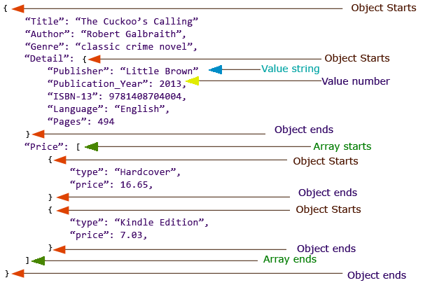
Best practices of json
REST API DEVELOPMENT
Understanding JSON Structure

Slide 11
Best practices of json
REST API DEVELOPMENT
JSON - Data Types
Type | Description
Number | Double- precision floating-point format in JavaScript
String | Double-quoted Unicode with backslash escaping
Boolean | True or False
Array | An ordered sequence of values
Value | It can be a string, a number, true or false, null etc
Object | An unordered collection of key:value pairs
Whitespace | Can be used between any pair of tokens
null | Empty

Slide 12
Best practices of json
REST API DEVELOPMENT
Bad Special Characters & Solution
Characters | Replace with
Backspace | \b
Form feed | \f
Newline | \n
Carriage return | \r
Tab | \t
Double quote | \"
Backslash | \\

Slide 13
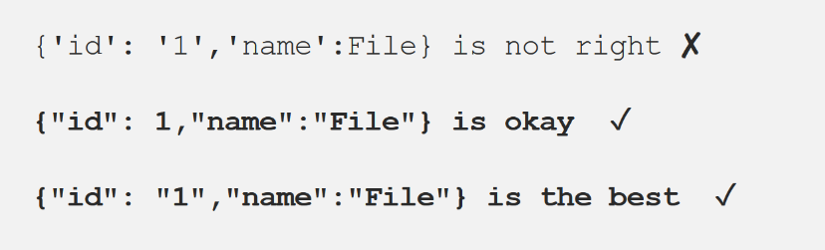
Best practices of json
REST API DEVELOPMENT
Always enclose the Key : Value pair within double quotes

Slide 14
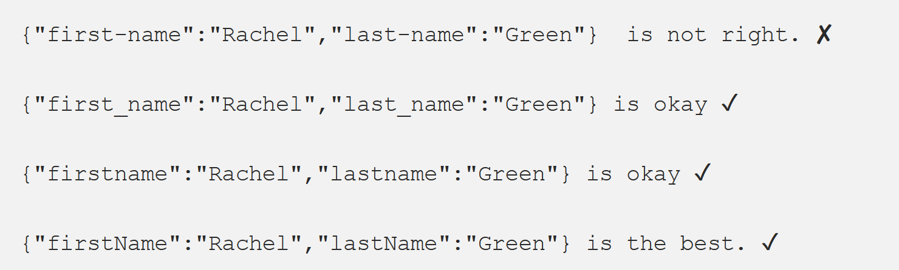
Best practices of json
REST API DEVELOPMENT
Never use Hyphens in your Key fields

Slide 15
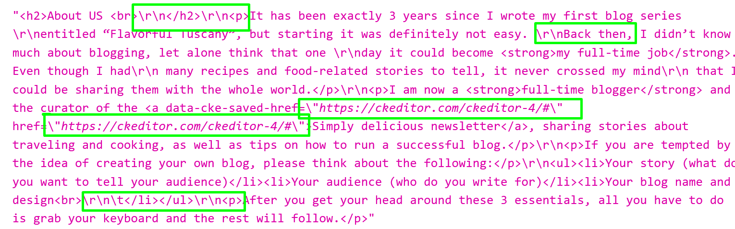
Best practices of json
REST API DEVELOPMENT
Bad Special Characters And Solution

Slide 16
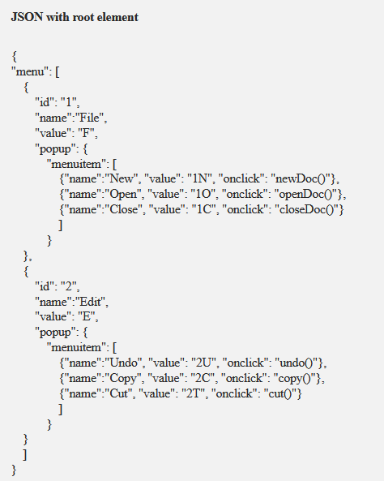
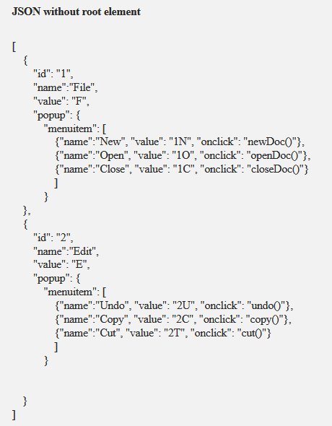
Best practices of json
REST API DEVELOPMENT
Always create a Root element.

Slide 17
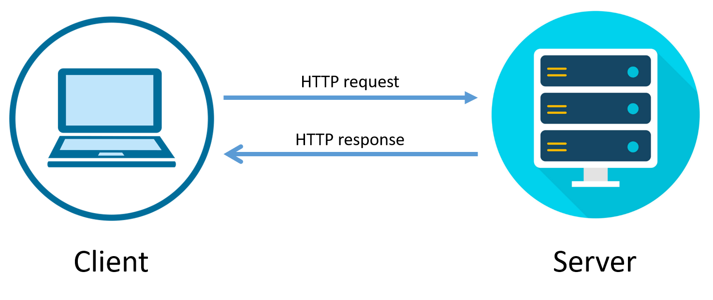
Request response model
REST API DEVELOPMENT
HTTP/HTTPS Request Response Communication
In request/response communication mode.
One software module sends a request to a second software module and waits for a response.
The First software module performs the role of the client.
The second, the role of the server,
This is called client/server interaction.

Slide 18
Request response model
REST API DEVELOPMENT
HTTP Client:.
Browser Level Client
Application Level Client

Slide 19

Request response model
REST API DEVELOPMENT
Browser Level Client
Browser is the primary HTTP Client responsible for load the web application.

Slide 20
Request response model
REST API DEVELOPMENT
Application Level Client :
HTTP Client is an application library used in client side application to generate request and receive response.
HTTP Client’s libraries varies from platform to platform
HTTP Client Library | Platform | Language
Volly | Native Android | Java
Retrofit | Native Android | Java
Rest Sharp | ASP.NET | C#
Axios | Mobile/Web/Desktop | JavaScript
cURL | Web | PHP
Alamofire | Native IOS | Swift

Slide 21
Request response model
REST API DEVELOPMENT
POSTMAN Http Client
Postman is an HTTP Client application, used to test request-response communication. Postman is widely used for API testing and generating documentation.
Quickly and easily send REST, SOAP, and GraphQL requests directly within Postman.
Generate and publish beautiful, machine-readable API documentation.
Checking performance and response times at scheduled intervals.
Communicate the expected behavior of an API by simulating endpoints and their responses

Slide 22
Request response model
REST API DEVELOPMENT
HTTP Request
HTTP Request is the first step to initiate web request/response communication. Every request is a combination of request header, body and request URL.
Http Request Segments:
Request Area | Standard Data Type
Body | Simple String, JSON, Download, Redirect, XML
Header | Key Pair Value
URL Parameter | String

Slide 23
Request response model
REST API DEVELOPMENT
HTTP Request Methods:
Method Name | Responsibilities
GET() | The GET method is used to retrieve information from the given server using a given URI. Requests using GET should only retrieve data and should have no other effect on the data.
Head() | Same as GET, but transfers the status line and header section only.
POST() | A POST request is used to send data to the server, for example, customer information, file upload, etc. using HTML forms.
PUT() | Replaces all current representations of the target resource with the uploaded content.
DELETE() | Removes all current representations of the target resource given by a URI.

Slide 24
Request response model
REST API DEVELOPMENT
Request Compare GET vs. POST:
Key Points | GET | POST
BACK button/Reload | Harmless | Data will be re-submitted (the browser should alert the user that the data are about to be re-submitted)
Bookmarked | Can be bookmarked | Cannot be bookmarked
Cached | Can be | Never
Encoding type | application/x-www-form-urlencoded | application/x-www-form-urlencoded or multipart/form-data. Use multipart encoding for binary data
History | Parameters remain in browser history | Parameters are not saved in browser history
Restrictions on data length | Yes, when sending data, the GET method adds the data to the URL; and the length of a URL is limited (maximum URL length is 2048 characters) | No restrictions

Slide 25
Request response model
REST API DEVELOPMENT
Request Compare GET vs. POST:
Key Points | GET | POST
Restrictions on data type | Only ASCII characters allowed | No restrictions. Binary data is also allowed
Security | GET is less secure compared to POST because data sent is part of the URL. Never use GET when sending passwords or other sensitive information! | POST is a little safer than GET because the parameters are not stored in browser history or in web server logs
Visibility | Data is visible to everyone in the URL | Data is not displayed in the URL

Slide 26
Request response model
REST API DEVELOPMENT
Http Request Throttling:
Throttle Request refers to a process in which a user is allowed to hit the application maximum time in per second or per minute. Throttling is also known as request rate limiting.
Essential component of Internet security, as DoS attacks can tank a server with unlimited requests.
Rate limiting also helps make your API scalable by avoid unexpected spikes in traffic, causing severe lag time.

Slide 27
Request response model
REST API DEVELOPMENT
HTTP Response:
Http response is the final step of request-response communication. Every response is a combination of response header, body an d cookies.
Http Response Segments:
Response Area | Standard Data Type
Body | Simple String, JSON, Download, Redirect, XML
Header | Key Pair Value
Cookies | Key Pair Value

Slide 28
Request response model
REST API DEVELOPMENT
HTTP Response status messages
Code | Meaning | Description
200 | OK | The request is OK (this is the standard response for successful HTTP requests)
201 | Created | The request has been fulfilled, and a new resource is created
202 | Accepted | The request has been accepted for processing, but the processing has not been completed
203 | Non-Authoritative Information | The request has been successfully processed, but is returning information that may be from another source
204 | No Content | The request has been successfully processed, but is not returning any content
205 | Reset Content | The request has been successfully processed, but is not returning any content, and requires that the requester reset the document view

Slide 29
Request response model
REST API DEVELOPMENT
HTTP Response status messages
Code | Meaning | Description
206 | Partial Content | The server is delivering only part of the resource due to a range header sent by the client
400 | Bad Request | The request cannot be fulfilled due to bad syntax
401 | Unauthorized | The request was a legal request, but the server is refusing to respond to it.
403 | Forbidden | The request was a legal request, but the server is refusing to respond to it
404 | Not Found | The requested page could not be found but may be available again in the future
405 | Method Not Allowed | A request was made of a page using a request method not supported by that page

Slide 30
Request response model
REST API DEVELOPMENT
HTTP Response status messages
Code | Meaning | Description
408 | Request Timeout | Request Timeout
500 | Internal Server Error | A generic error message, given when no more specific message is suitable
502 | Bad Gateway | The server was acting as a gateway or proxy and received an invalid response from the upstream server
503 | Service Unavailable | The server is currently unavailable (overloaded or down)

Slide 31
API End Naming Best Practice
REST API DEVELOPMENT
URIs as resources as nouns:
One of the most recognizable characteristics of REST is the predominant use of nouns in URIs. Restful URIs should
not indicate any kind of CRUD (Create, Read, Update, and Delete) functionality. Instead, REST APIs should allow you to
manipulate a resource.

Slide 32
API End Naming Best Practice
REST API DEVELOPMENT
Forward slashes for hierarchy:
As shown in the examples above, forward slashes are conventionally used to show the hierarchy between individual resources and collections

Slide 33
API End Naming Best Practice
REST API DEVELOPMENT
Punctuation for lists:
When there is no hierarchical relationship (such as in lists), punctuation marks such as the semicolon, or, more frequently, the comma should be used.

Slide 34
API End Naming Best Practice
REST API DEVELOPMENT
Query parameters where necessary:
In order to sort or filter a collection, a REST API should allow query parameters to be passed in the URI.

Slide 35
API End Naming Best Practice
REST API DEVELOPMENT
Lowercase letters and dashes:
By convention, resource names should use exclusively lowercase letters. Similarly, dashes (-) are conventionally used in place of underscores (_).

Slide 36
API End Naming Best Practice
REST API DEVELOPMENT
No file extensions:
Leave file extensions (such as .xml) out of your URIs. We’re sorry to say it, but they’re ugly and add length to URIs. If you need to specify the format of the body, instead use the Content-Type header

Slide 37
API End Naming Best Practice
REST API DEVELOPMENT
No trailing forward slash: Similarly, in the interests of keeping URIs clean, do not add a trailing forward slash to the end of URIs.

Slide 38
API Response Best Practices
REST API DEVELOPMENT
Response Header:
Provide proper http response status code.
Provide proper content type, file type if any.
Provide cache status if any.
Authentication token should provide via response header.
Only string data is allowed for response header.
Provide content length if any.
Provide response date and time.
Follow request-response model described before.

Slide 39
API Response Best Practices
REST API DEVELOPMENT
Response Body:
Avoid providing response status, code, message via response body
Use JSON best practices for JSON response body.
For single result, can use String, Boolean directly.
Provide proper JSON encode-decode before writing JSON Body.
Follow discussion on JSON described before.

Slide 40
API Response Best Practices
REST API DEVELOPMENT
Response Cookies:
A Restful API may send cookies just like a regular Web Application that serves HTML
Avoid using response cookies as it is violate stateless principle.
If required use cookie encryption, decryption and other policies

Slide 41
API Request Handling Best Practices
REST API DEVELOPMENT
When use GET():
•GET is used to request something from server with less amount of data to pass.
•When nothing should change on the server because of your action.
•When request only retrieves data from a web server by specifying parameters
•Get method only carries request url & header not request body.
When use POST():
POST should be used when the server state changes due to that action.
When request needs its body, to pass large amount of data.
When want to upload documents , images , video from client to server

Slide 42
API Request Handling Best Practices
REST API DEVELOPMENT
Request Body:
Request body should be structured in JSON Array/ Object pattern
Request body hold multipart/ form-data like images, audio, video etc
Request body should not hold any auth related information.
Request body should associated with specific request data model, setter getter can used for this
Request Header:
Request header should carry all security related information, like token, auth etc.
Only string Key:Pair value is allowed for header .
Request header should provide user agent information of client application.
If necessary CSRF/ XSRF should provide via header.
Request header should associated with middleware controller, where necessary

Slide 43
API Request Handling Best Practices
REST API DEVELOPMENT
API Controller Best Practices
The controllers should always be as clean as possible. We shouldn’t place any business logic inside it.
Controllers should be responsible for accepting http request
Consider API versioning
Use async/await if at all possible.
Follow solid principles to manage controller classes.
Mention which method is responsible for GET() and which for POST().
Controller should be only responsible for calling model, return response , redirect to action etc.

Slide 44
API Request Handling Best Practices
REST API DEVELOPMENT
API Middleware Controller Best Practices
Middleware is a special types of controller executed after request but before in response. It is a type of filtering mechanism to ensure API securities and more. Middleware acts as a bridge between a request and a response.
Middleware Uses:
Use to implement API key, user-agent restriction, CSRF, XSRF security, token based API authentication.
Use to implement API request rate limit.
Logging of incoming HTTP requests.
Redirecting the users based on requests.
Middleware can inspect a request and decorate it, or reject it, based on what it finds.
Middleware is most often considered separate from your application logic.
Middleware gives you enough freedom to create your own security mechanism.

Slide 45
REST API Security Best Practices
REST API DEVELOPMENT
Security Practices May Varies
May varies from application to application
May varies from developer to developer
May varies from environment to environment
May varies from use case to use case
But we have to know
The best practices
Know about the security layers
Security placement

Slide 46
REST API Security
REST API DEVELOPMENT
Client Application
API END POINT
Request
API Key Verification
User Agent Verification
CSRF Protection
Response
Rate Limiting
Security Layer
HTTP Secure Headers
Parameter Pollution
Payload Validation
Controller
Data Sanitization
Response Validation
Authentication/Authorization

Slide 47
REST API Security Best Practices
REST API DEVELOPMENT
Output Validation
Output Header:
Provide proper http response status code.
Provide proper content type, file type if any.
Provide cache status if any.
Authentication token should provide via response header.
Only string data is allowed for response header.
Provide content length if any.
Provide response date and time.
Follow request-response model described before.
Output Body:
Avoid providing response status, code, message via response body
Use JSON best practices for JSON response body.
For single result, can use String, Boolean directly.
Provide proper JSON encode-decode before writing JSON Body.
Follow discussion on JSON described before.

Slide 48
REST API Security Best Practices
REST API DEVELOPMENT
Request Rate limit- Throttling
We need to make sure our APIs are running as efficiently as possible. Otherwise, everyone using your database
will suffer from slow performance. Performance isn’t the only reason to limit API requests, either. API limiting, which also known
as rate is limiting, is an essential component of Internet security, as DoS attacks can tank a server with unlimited API requests.
Rate limiting also helps make your API scalable. If your API blows up in popularity, there can be unexpected spikes in traffic,
causing severe lag time.
Language | Platform | Library name | Library Sources
C# | ASP.NET | WebApiThrottle, MvcThrottle | Nuget package manager
PHP | Laravel | Laravel Karnel Default | Packagist
JS | Node/Express JS | express-rate-limit | NPM

Slide 49
REST API Security Best Practices
REST API DEVELOPMENT
CSRF/XSRF Protection
Cross-site request forgery attacks (CSRF or XSRF for short) are used to send malicious requests from an authenticated user to a web application.
Use request-response header to pass CSRF token
CSRF token should be unique for every session
For self API CSRF token works well.
Language | Platform | Library name | Library Sources
C# | ASP.NET | AntiCSRF | Nuget package manager
PHP | Laravel | Laravel Default | Packagist
JS | Node/Express JS | npm i csrf | NPM

Slide 50
REST API Security Best Practices
REST API DEVELOPMENT
User Agent Protection
User agent is a request header property, describe client identity like operating system, browser details, device details etc. Moreover every web crawler like Google crawler, Facebook crawler has specific user-agent name.
Using user agent we can prevent REST API from search engine indexing, social media sharing.
Can stop subspecies request from who is hiding his identity.
We can add user agent along with REST API usage history.
We can add device/OS usage restriction.

Slide 51
REST API Security Best Practices
REST API DEVELOPMENT
Platform | Example User Agent Like
Android web browser | Mozilla/5.0 (Linux; Android 6.0.1; RedMi Note 5 Build/RB3N5C; wv) AppleWebKit/537.36 (KHTML, like Gecko) Version/4.0 Chrome/68.0.3440.91 Mobile Safari/537.36
IOS web browser | Mozilla/5.0 (iPhone; CPU iPhone OS 12_3_1 like Mac OS X) AppleWebKit/605.1.15 (KHTML, like Gecko) Version/12.1.1 Mobile/15E148 Safari/604.1
Windows | Mozilla/5.0 (Windows NT 10.0; Win64; x64) AppleWebKit/537.36 (KHTML, like Gecko) Chrome/74.0.3729.169 Safari/537.36
Mac | Mozilla/5.0 (Macintosh; Intel Mac OS X 10_11_6) AppleWebKit/605.1.15 (KHTML, like Gecko) Version/11.1.2 Safari/605.1.15
Google BOT | Mozilla/5.0 (compatible; Googlebot/2.1; +http://www.google.com/bot.html)
Facebook BOT | facebookexternalhit/1.0 (+http://www.facebook.com/externalhit_uatext.php)

Slide 52
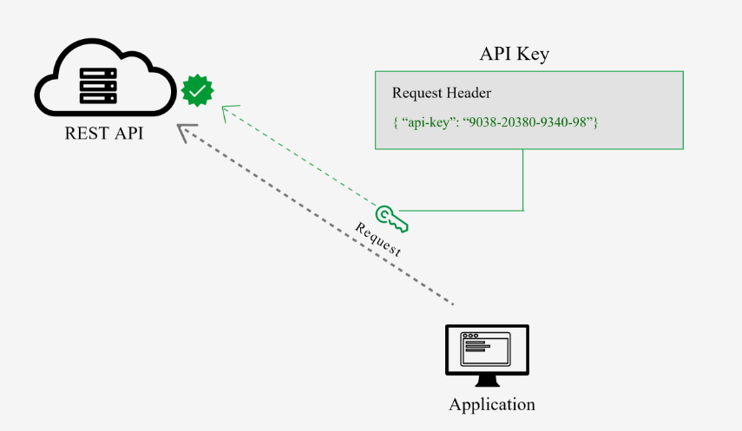
REST API Security Best Practices
REST API DEVELOPMENT
API Key
This is the most straightforward method and the easiest way for auth
With this method, the sender places a username:password/ ID / Keys into the request header.
The credentials are encoded and decode to ensure safe transmission.
This method does not require cookies, session IDs, login pages, and other such specialty solutions

Slide 53
REST API Security Best Practices
REST API DEVELOPMENT
Bearer Authentication/ Auth 2.0
গাড়ির গ্যারেজ এর টোকেন সিস্টেম

Slide 54
REST API Security Best Practices
REST API DEVELOPMENT
Bearer Authentication/ Auth 2.0
Bearer authentication (also called token authentication) is an HTTP authentication scheme that involves security tokens called bearer tokens, passes through request-response header. In General JSON Web Tokens JWT used for this purposes.
Language | Platform | Library name | Library Sources
C# | ASP.NET | JwtBearer, jose-jwt | Nuget package manager
PHP | Laravel | firebase / php-jwt | GitHub
JS | Node/Express JS | npm i jsonwebtoken | NPM

Slide 55
REST API Security Best Practices
REST API DEVELOPMENT
JWT (JSON WEB TOKEN):
Compact and self-contained way for securely transmitting information between parties as a JSON object.
Information can be verified and trusted because it is digitally signed.
USES:
Authorization: Allowing the user to access routes, services, and resources
Information Exchange: Way of securely transmitting information between parties.

Slide 56
REST API Security Best Practices
REST API DEVELOPMENT
JSON WEB TOKEN STRUCTURE :
Header
Payload
Signature

Slide 57
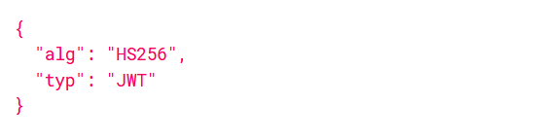
REST API Security Best Practices
REST API DEVELOPMENT
JSON WEB TOKEN HEADER :
Type of the token
Signing algorithm

Slide 58
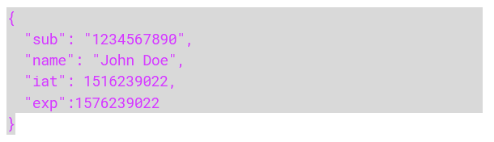
REST API Security Best Practices
REST API DEVELOPMENT
JSON WEB TOKEN PAYLOAD:
Registered claims: iss (issuer), exp (expiration time), sub (subject), aud (audience)
Public claims: These can be defined at will by those using JWTs.
Private claims: These are the custom claims created to share information between parties.

Slide 59
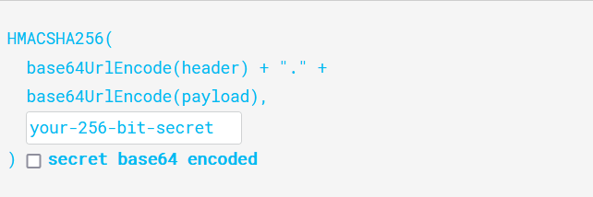
REST API Security Best Practices
REST API DEVELOPMENT
JSON WEB TOKEN SIGNATURE
To create the signature part -
Take the encoded header
Take the encoded payload, a secret
The algorithm specified in the header

Slide 60
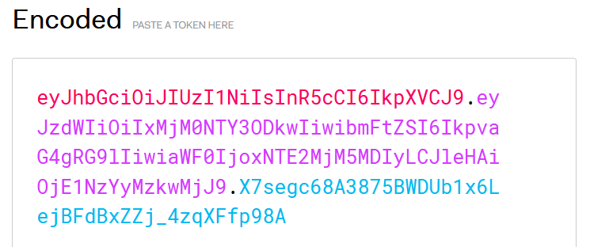
REST API Security Best Practices
REST API DEVELOPMENT
JSON WEB TOKEN
Putting all together

Slide 61
Express Rest API Packages
REST API DEVELOPMENT
Essential Packages:
Express: The core backbone
Body-parser: This is a node.js middleware for handling JSON, Raw, Text and URL encoded form data.
Cookie-parser: Used to parse Cookie header and populate req.cookies with an object keyed by the cookie names.
Multer: This is a node.js middleware for handling multipart/form-data.
Jsonwebtoken: Securely transmitting information between parties as a JSON object
MySQL Driver: To access a MySQL database with Node.js
Mongo dB Driver: To access a Mongo database with Node.js

Slide 62
Express Rest API Packages
REST API DEVELOPMENT
Essential Packages:
Dotenv: Dotenv is a zero-dependency module that loads environment variables
Cors: CORS is a node.js package for providing a Connect/Express middleware that can be used to enable CORS with various options.
Express-mongo-sanitize: Sanitizes user-supplied data to prevent MongoDB Operator Injection.
Express-rate-limit: Rate-limiting middleware for Express. Use to limit repeated requests to public APIs and/or endpoints.
Helmet: Helmet helps you secure your Express apps by setting various HTTP headers.
HPP: Express middleware to protect against HTTP Parameter Pollution attacks
Validator: A library of string validators and sanitizers.
Xss-clean: Connect middleware to sanitize user input coming from POST body, GET queries, and url params.

Slide 63
Express Rest API Structure
REST API DEVELOPMENT
File Folder Structure
For Monolithic Application MVC (Model, View, Controller)
For Rest API MC (Model, Controller )

Slide 64
Express Rest API Structure
REST API DEVELOPMENT
File Folder Structure
Index.js : Responsible for connecting the MongoDB and starting the server.
App.js : Configure everything that has to do with Express application.
Config.env: for Enivrement Variables.
Routes -> Routes.js: The goal of the route is to guide the request to the correct handler function which will be in one of the controllers.
Controllers -> Controller.js: Handle the application request, interact with models and send back the response to the client.
Models -> Model.js: If we use Mongoose this will be schema definition for creating and reading documents from the underlying MongoDB database.

Slide 65


Express Rest API Structure
REST API DEVELOPMENT
File Folder Structure:
Routing End Point
Controller
Client Script
Database
Model

Slide 66
Create My Express Rest API Project
REST API DEVELOPMENT
Create a project folder
Create package.json
Install express
Install node packages
Create index.js @ root
Create app.js @root
Create config.env @root
Create src directory
Create src->controllers folder
Create src->models folder
Create src->routes folder

